Slide 1
Probability
Prepared by
Sajana Shakya

Slide 2
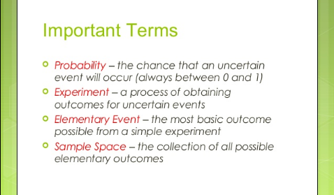

Slide 3
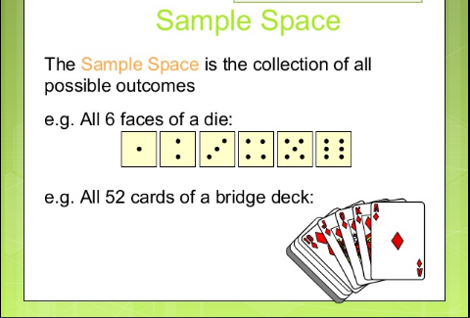

Slide 4
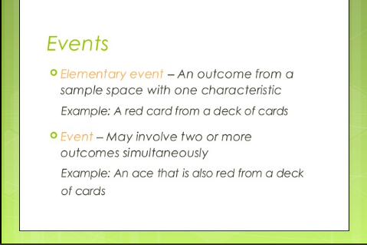

Slide 5
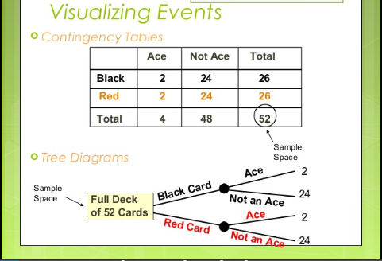

Slide 6
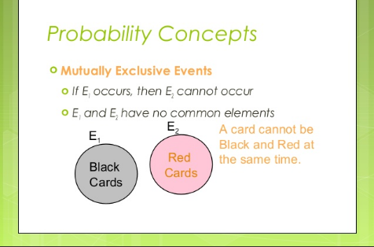

Slide 7
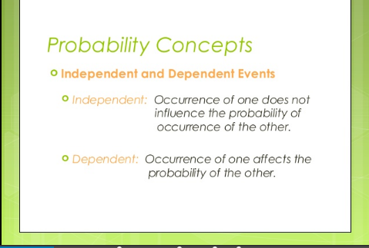

Slide 8
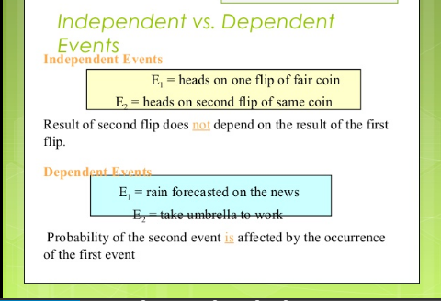

Slide 9
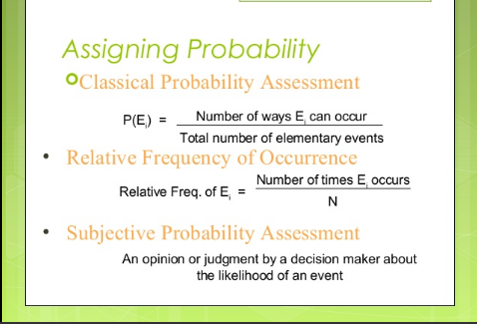

Slide 10
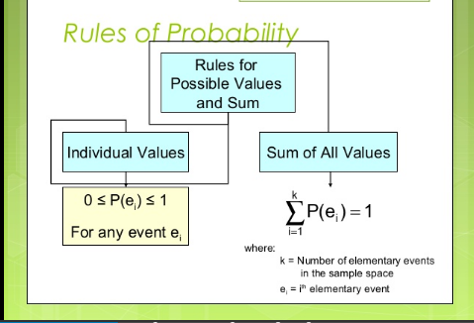

Slide 11
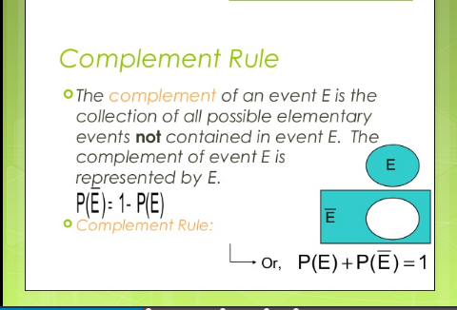

Slide 12
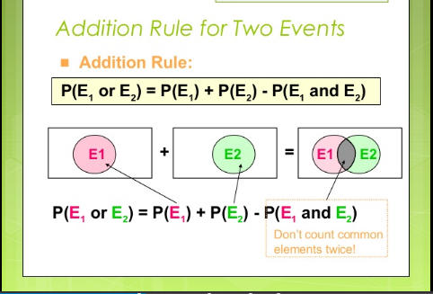
Addition law of Probability
When events are not mutually exclusive:

Slide 13
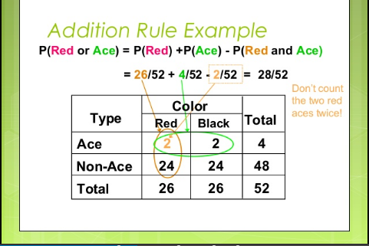
Addition law of Probability
When events are not mutually exclusive:

Slide 14
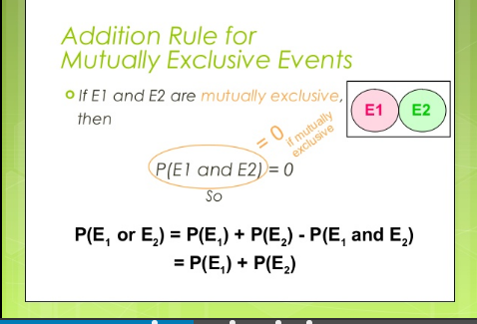
Addition law of Probability
When events are Mutually Exclusive:

Slide 15
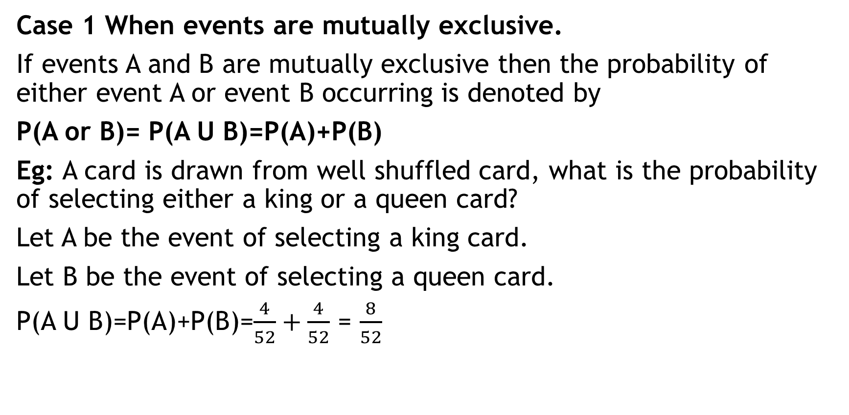
Addition law of Probability
Case 1 When events are mutually exclusive.
If events A and B are mutually exclusive then the probability of either event A or event B occurring is denoted by
P(A or B)= P(A U B)=P(A)+P(B)
Eg: A card is drawn from well shuffled card, what is the probability of selecting either a king or a queen card?
Let A be the event of selecting a king card.
Let B be the event of selecting a queen card.
P(A U B)=P(A)+P(B)=$\frac{4}{52}+\frac{4}{52}$ = $\frac{8}{52}$

Slide 16

Multiplication law of Probability
When events are dependent:

Slide 17
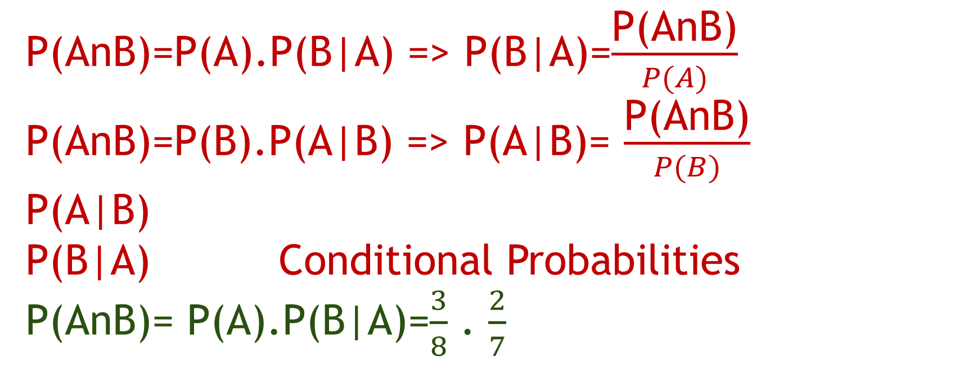
P(AnB)=P(A).P(B|A) => P(B|A)=$\frac{\text{P}\text{(}\text{AnB}\text{)}}{P(A)}$
P(AnB)=P(B).P(A|B) => P(A|B)= $\frac{\text{P}\text{(}\text{AnB}\text{)}}{P(B)}$
P(A|B)
P(B|A) Conditional Probabilities
P(AnB)= P(A).P(B|A)=$\frac{3}{8}$ . $\frac{2}{7}$
3 def.
5 non def.

Slide 18
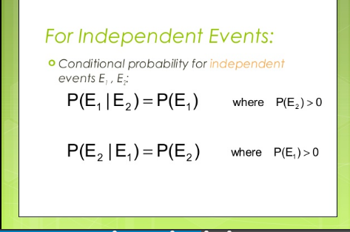
Multiplication law of Probability
When events are independent:

Slide 19
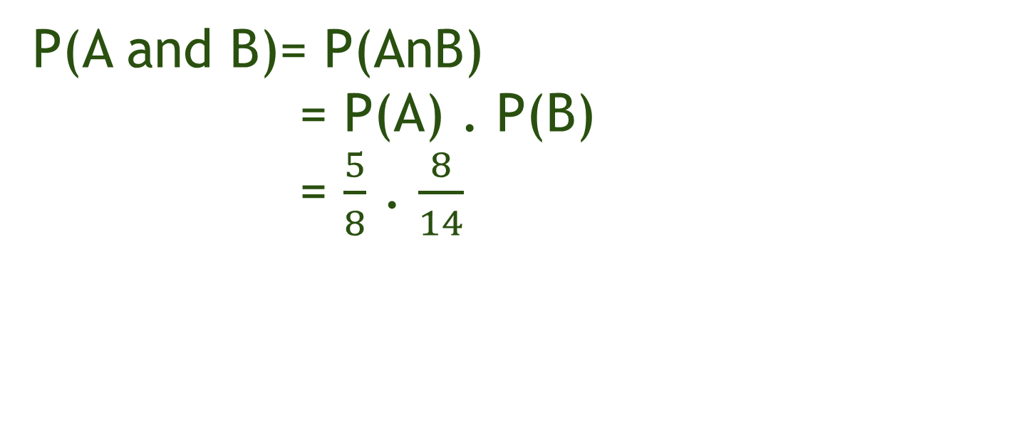
P(A and B)= P(AnB)
= P(A) . P(B)
= $\frac{5}{8}$ . $\frac{8}{14}$
5R
3B
8R
6B

Slide 20
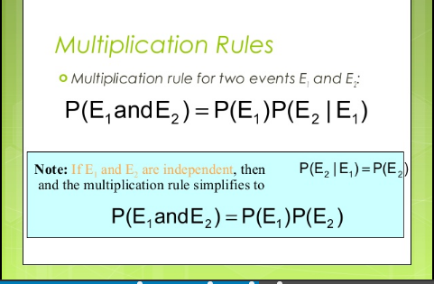
Multiplication law of Probability
When events are independent:

Slide 21
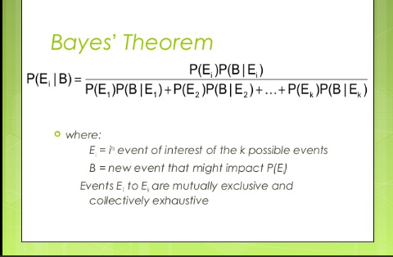

Slide 22
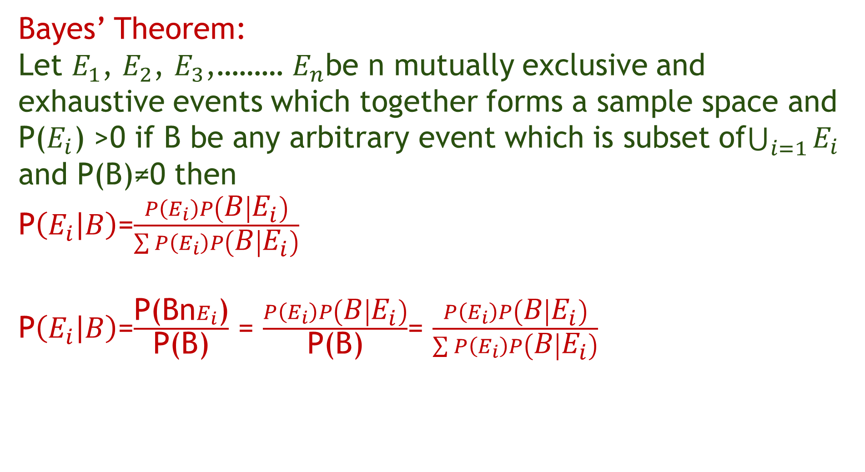
Bayes’ Theorem:
Let $E_{1}$, $E_{2}$, $E_{3}$,……… $E_{n}$be n mutually exclusive and exhaustive events which together forms a sample space and P($E_{i}$) >0 if B be any arbitrary event which is subset of$\bigcup_{i=1}{E_{i}}$ and P(B)≠0 then
P$\left(E_{i} | B\right)$=$\frac{P\left(E_{i}\right)P\left(B | E_{i}\right)}{\sum{P\left(E_{i}\right)P\left(B | E_{i}\right)}}$
P$\left(E_{i} | B\right)$=$\frac{\text{P}\text{(}\text{Bn}E_{i}\text{)}}{\text{P}\text{(}\text{B}\text{)}}$ = $\frac{P\left(E_{i}\right)P\left(B | E_{i}\right)}{\text{P}\text{(}\text{B}\text{)}}$= $\frac{P\left(E_{i}\right)P\left(B | E_{i}\right)}{\sum{P\left(E_{i}\right)P\left(B | E_{i}\right)}}$
B
B

Slide 23
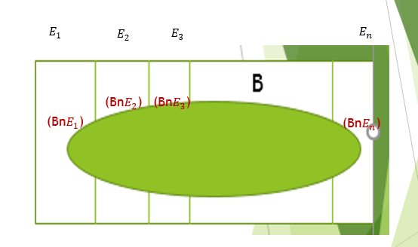
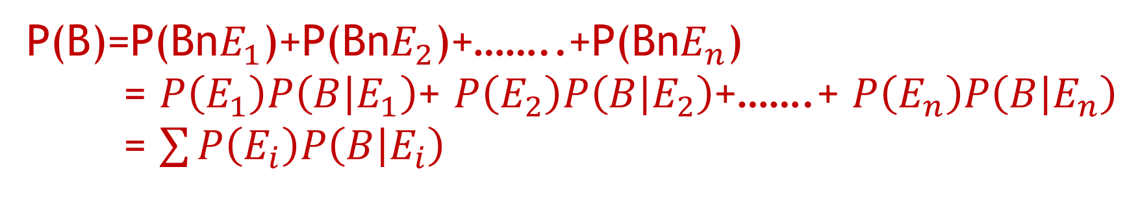
P(B)=P(Bn$E_{1}$)+P(Bn$E_{2}$)+……..+P(Bn$E_{n}$)
= $P\left(E_{1}\right)P\left(B | E_{1}\right)$+ $P\left(E_{2}\right)P\left(B | E_{2}\right)$+…….+ $P\left(E_{n}\right)P\left(B | E_{n}\right)$
= $\sum{P\left(E_{i}\right)P\left(B | E_{i}\right)}$

Slide 24
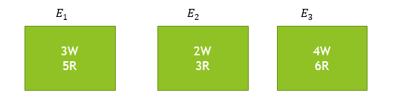
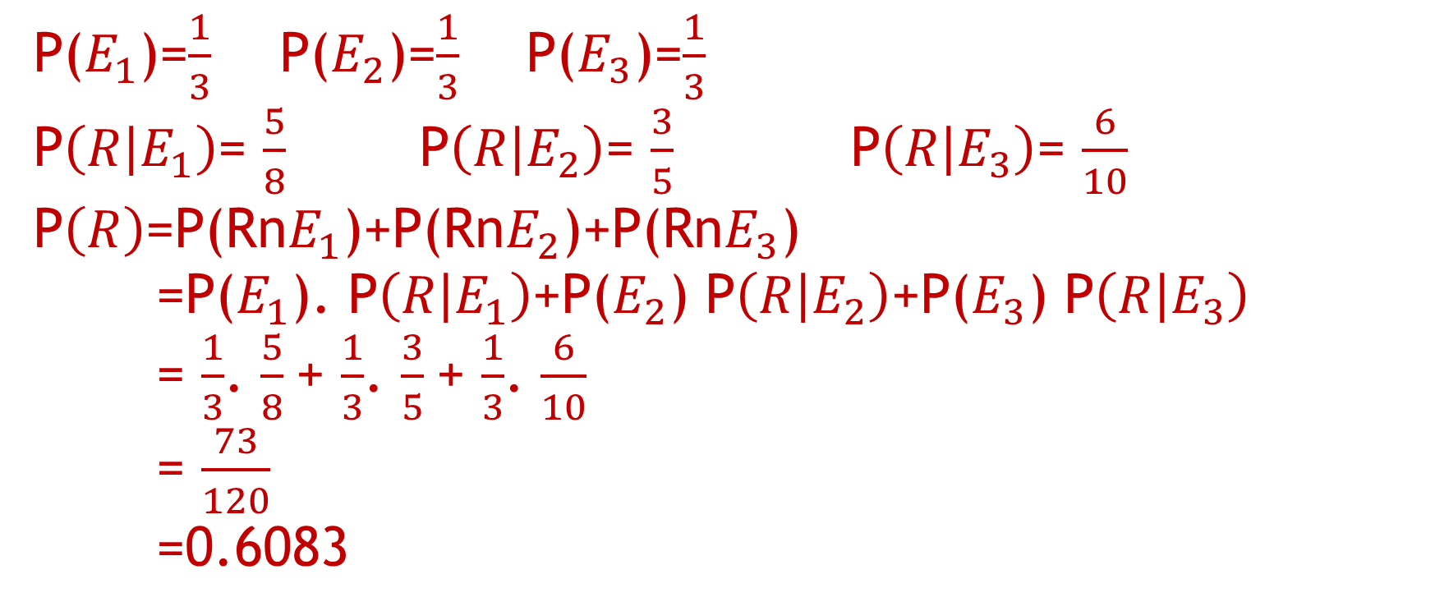
P($E_{1}$)=$\frac{1}{3}$ P($E_{2}$)=$\frac{1}{3}$ P($E_{3}$)=$\frac{1}{3}$
P$\left(R | E_{1}\right)$= $\frac{5}{8}$ P$\left(R | E_{2}\right)$= $\frac{3}{5}$ P$\left(R | E_{3}\right)$= $\frac{6}{10}$
P$\left(R\right)$=P(Rn$E_{1}$)+P(Rn$E_{2}$)+P(Rn$E_{3}$)
=P($E_{1}$). P$\left(R | E_{1}\right)$+P($E_{2}$) P$\left(R | E_{2}\right)$+P($E_{3}$) P$\left(R | E_{3}\right)$
= $\frac{1}{3}$. $\frac{5}{8}$+ $\frac{1}{3}$. $\frac{3}{5}$+ $\frac{1}{3}$. $\frac{6}{10}$
= $\frac{73}{120}$
=0.6083

Slide 25
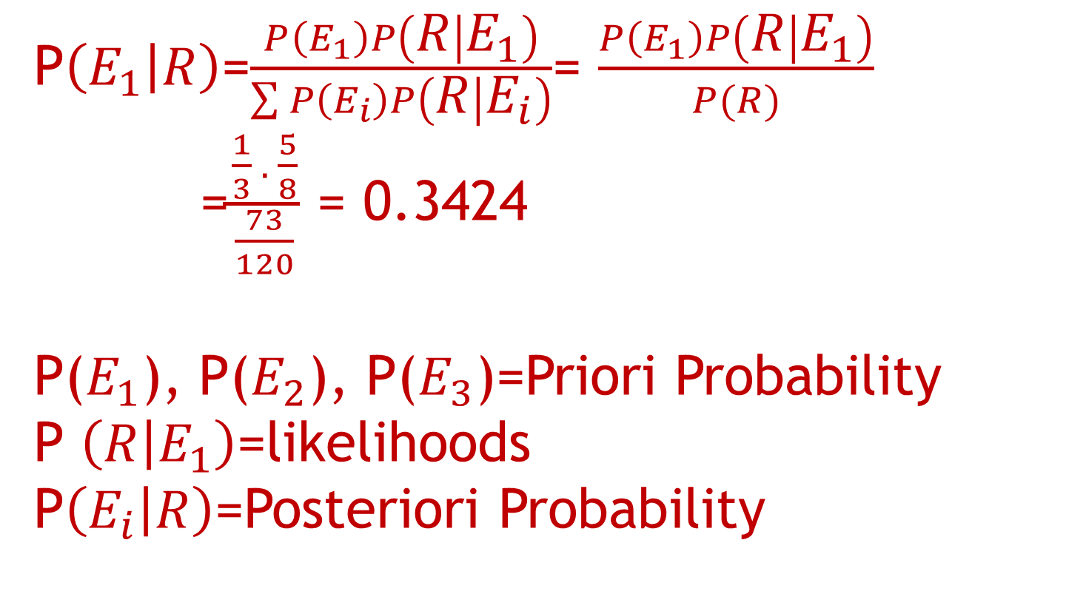
P$\left(E_{1} | R\right)$=$\frac{P\left(E_{1}\right)P\left(R | E_{1}\right)}{\sum{P\left(E_{i}\right)P\left(R | E_{i}\right)}}$= $\frac{P\left(E_{1}\right)P\left(R | E_{1}\right)}{P(R)}$
=$\frac{\frac{1}{3} . \frac{5}{8}}{\frac{73}{120}}$ = 0.3424
P($E_{1}$), P($E_{2}$), P($E_{3}$)=Priori Probability
P $\left(R | E_{1}\right)$=likelihoods
P$\left(E_{i} | R\right)$=Posteriori Probability

Slide 26
Problem1:
Two sets of candidates are competing for the position on the board of directors of a company. The probabilities that the first and second sets will win are 0.60 and 0.40 respectively. If the first set wins, the probability of introducing a new product is 0.80 and the corresponding probability if second set win is 0.30. what is the probability that the new product will be introduced?

Slide 27
Problem 2:
In a class of BE, there are 20 boys and 30 girls. The two students have to be selected as class representative. What is the probability that both are boys?
Problem 3:
In a company out of 20 candidates 14 men and 6 women apply for two vacancies. What is the probability that (i) both men are selected (ii) both women are selected (iii) one man and one women are selected ?

Slide 28
Problem 4:
A chain of video stores sells three different brands of DVD players; Of its DVD players sales,50% are brand 1, 30 % are brand 2, and 20% are brand 3. Each manufacturer offers a 1-year warranty on parts and labor. It is known that 25% of brand 1’s DVD players require warranty repair work, where as the corresponding percentages for brands 2 and 3 are 20% and 10 %, respectively. a) What is the probability that a randomly selected purchaser has bought a brand 1 DVD player that will need repair while under warranty? b) What is the probability that a randomly selected purchaser has a DVD player that will need repair while under warranty?

